Slide 1
Normal Mode Analysis (NMA)
NMA provides information on the equilibrium modes accesible to a molecular system, assuming that the system is stabilized by harmonic potentials
A major reason behind the widespread use of NMA to study proteins is the observation that normal modes obtained with NMA bear functional significance
Normal modes represent conformational changes along directions (principal axes) that require the least energy for a given deformation. Given that the energy landscape is defined by the molecular structure, the normal modes are structure-encoded by definition
A striking feature of NMA of proteins is the observed robustness of the normal modes to details in atomic coordinates or specific interatomic interactions. The normal modes are defined by the entire structure (architecture)
The property that apparently dominates the shape of normal modes is the network of inter-residue contacts, which is a purely geometrical quantity defined by the overall shape and the contact
topology of the protein

Slide 2
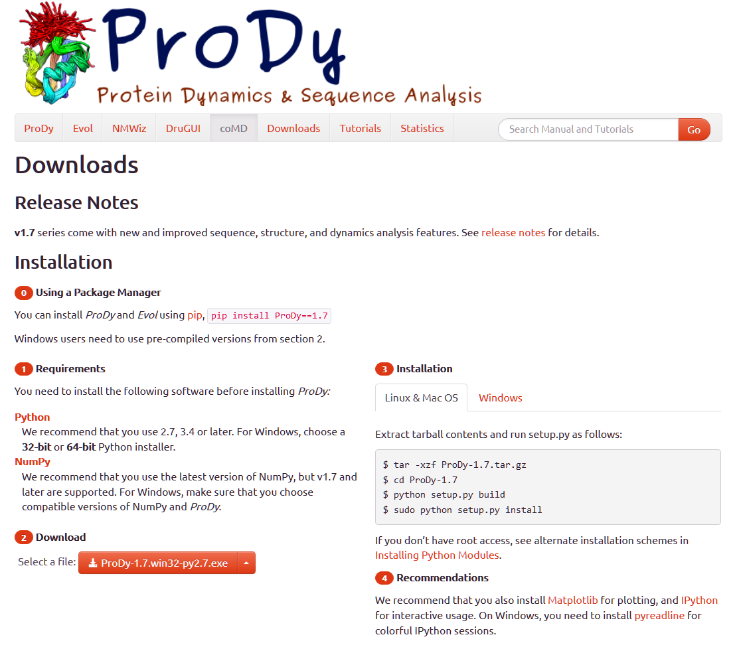
Normal Mode Analysis (NMA)
prody.csb.pitt.edu/downloads

Slide 3

Normal Mode Analysis (NMA)
prody.csb.pitt.edu/

Slide 4
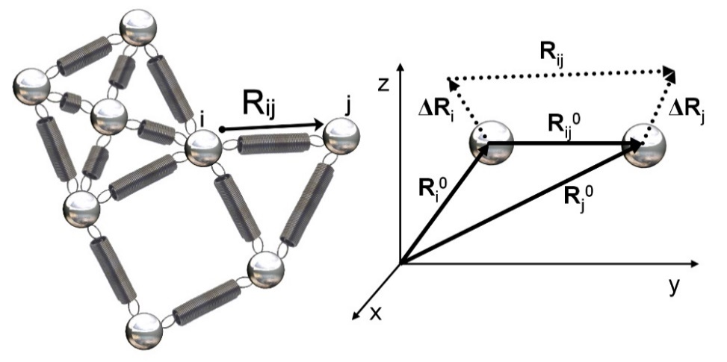
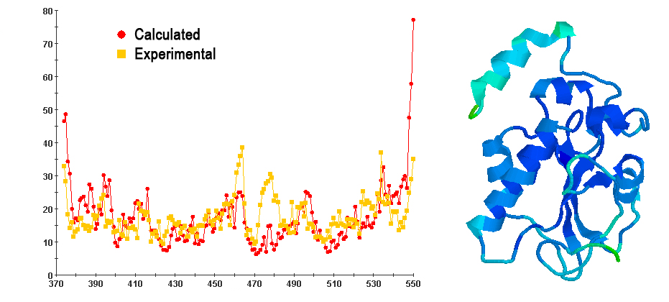
NMA: Gaussian Network Model (GNM)
1
Nodes in elastic network of GNM. Every node is connected to its neighbors by uniform springs
R⁰_{i},R⁰_{j}: equilibrium positions of ith and jth nodes
R⁰_{ij}: equilibrium distance between nodes i and j
ΔR_{i}, ΔR_{j}: instantaneous fluctuation vectors
R_{ij}: instantaneous distance vector
Catalytic domain of Cdc25B, a cell division cycle dual-specificity phosphatase (1QB0)
2
B-factor (Å²)
Residue
1: en.wikipedia.org/wiki/Gaussian_network_model 2: L. W. Yang et al., (2005) Bioinformatics, 21:2978-2987

Slide 5
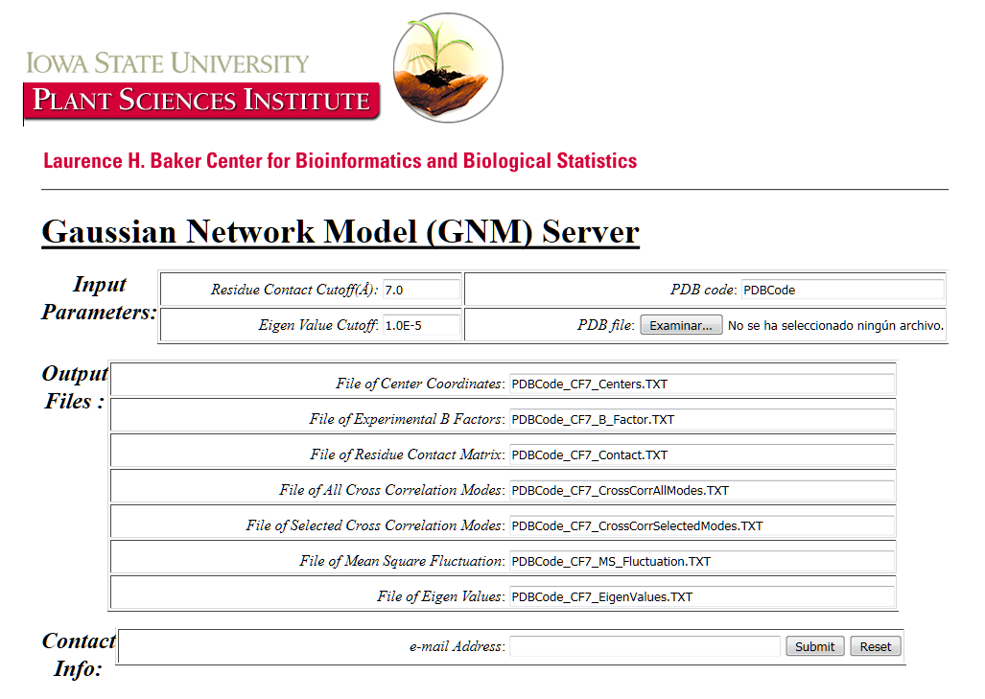
Gaussian Network Model (GNM)
gor.bb.iastate.edu/gnm/gnm.htm

Slide 6
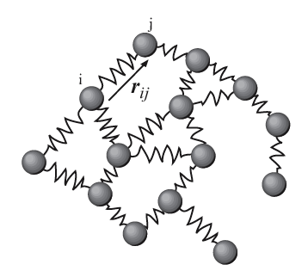
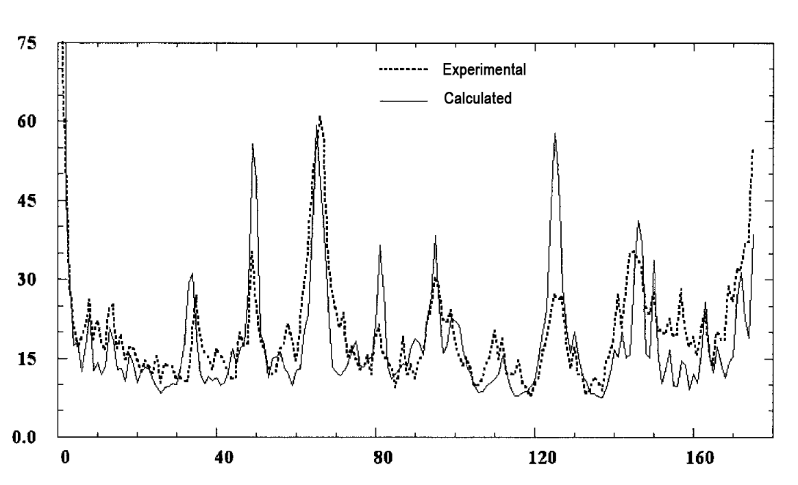
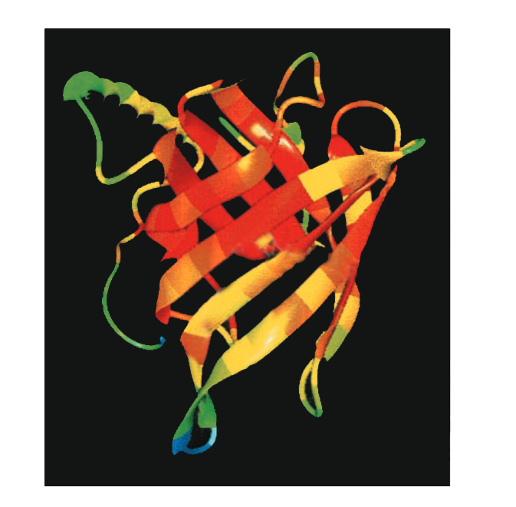
NMA: Anisotropic Network Model (ANM)
1
Elastic mass-and-spring network to
represent the macromolecule
Retinol-binding protein (1AQB)
2
B-factor (Å²)
Residue
1: en.wikipedia.org/wiki/Anisotropic_network_model 2: A. R. Atilgan et al., (2001) Biophys. J., 80:505-515

Slide 7
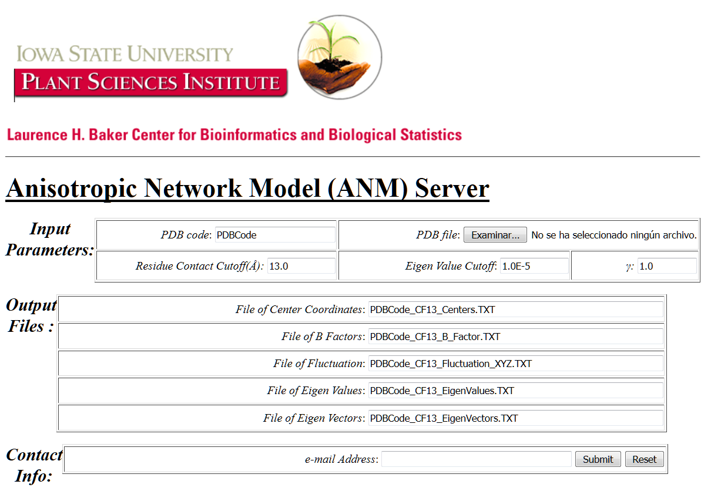
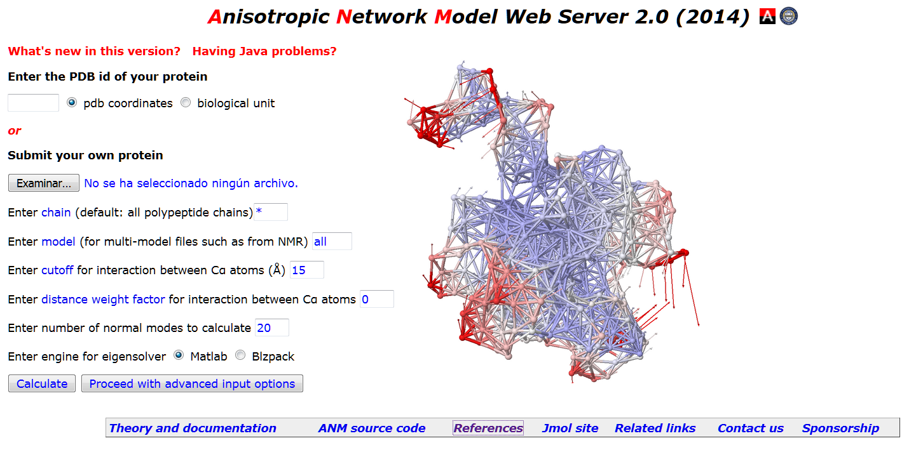
Anisotropic Network Model (ANM)
gor.bb.iastate.edu/anm/anm.htm
anm.csb.pitt.edu/cgi-bin/anm2/anm2.cgi

Slide 8
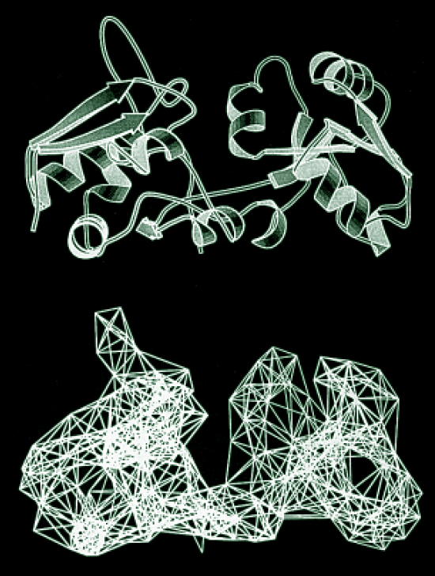
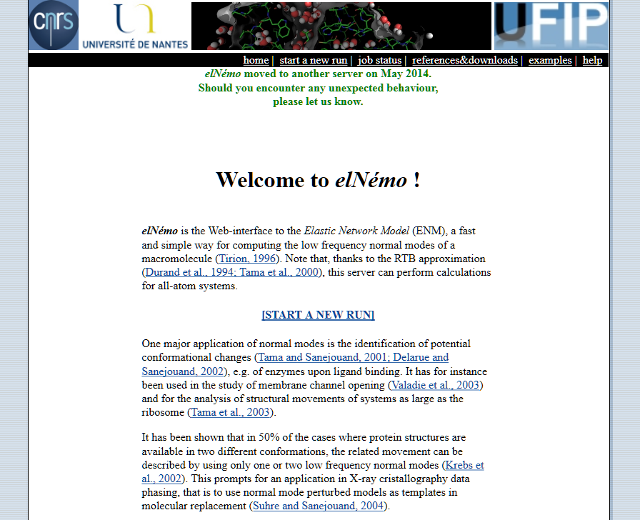
Elastic Network Model (elNémo)
1
www.sciences.univ-nantes.fr/elnemo/index.html
1: F.Tama, Y. H. Sanejouand (2001), Protein Engin. 14:1-6

Slide 9
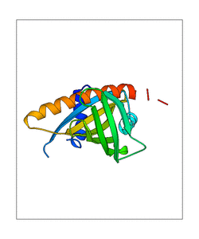
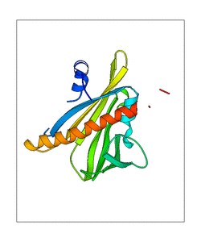
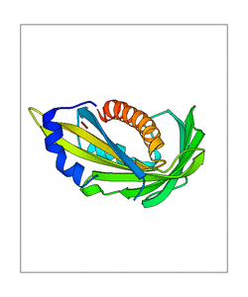
Elastic Network Model (elNémo)
Three animated views of normal mode 7 in the abscisic acid receptor (chain B) from Arabidopsis (3K3K) calculated with ElNémo server
LFP

Slide 10
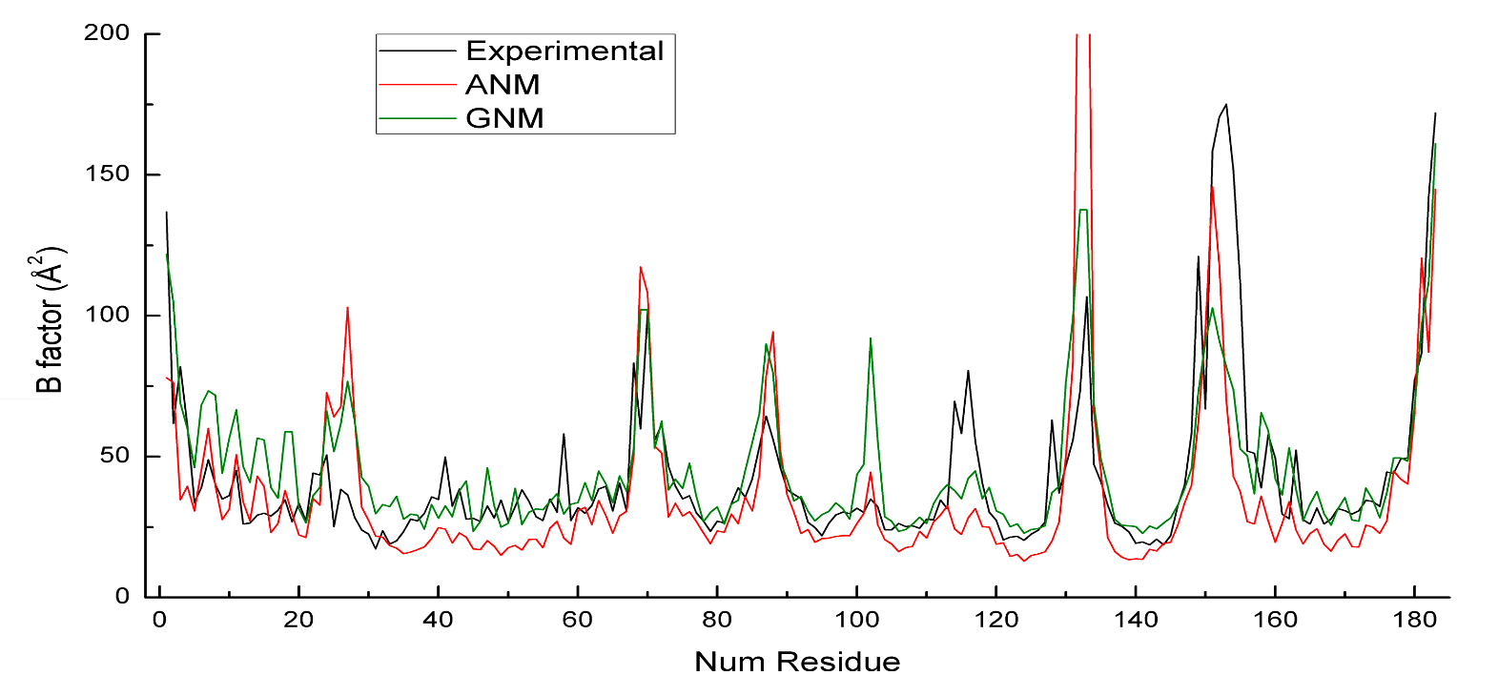
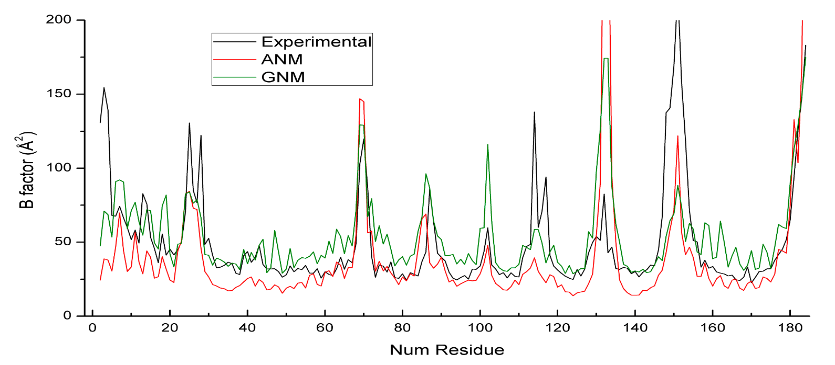
Abscisic acid receptor from Arabidopsis (3K3K).
B factors calculated with ANM and GNM compared with experimental data in 3K3K crystal structure
Chain A
Chain B
LFP

Slide 11
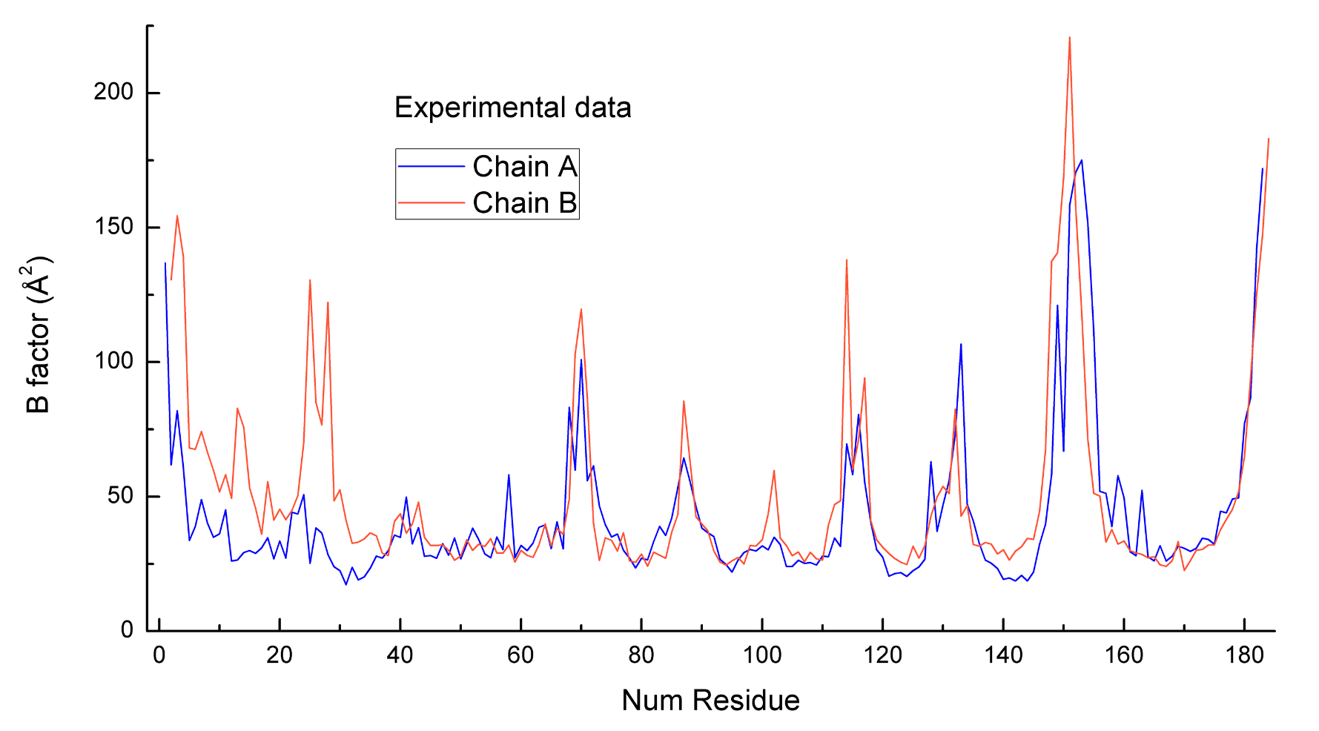
Abscisic acid receptor from Arabidopsis (3K3K).
Experimental B factors in the 3K3K crystal structure for chains A and B
LFP

Slide 12
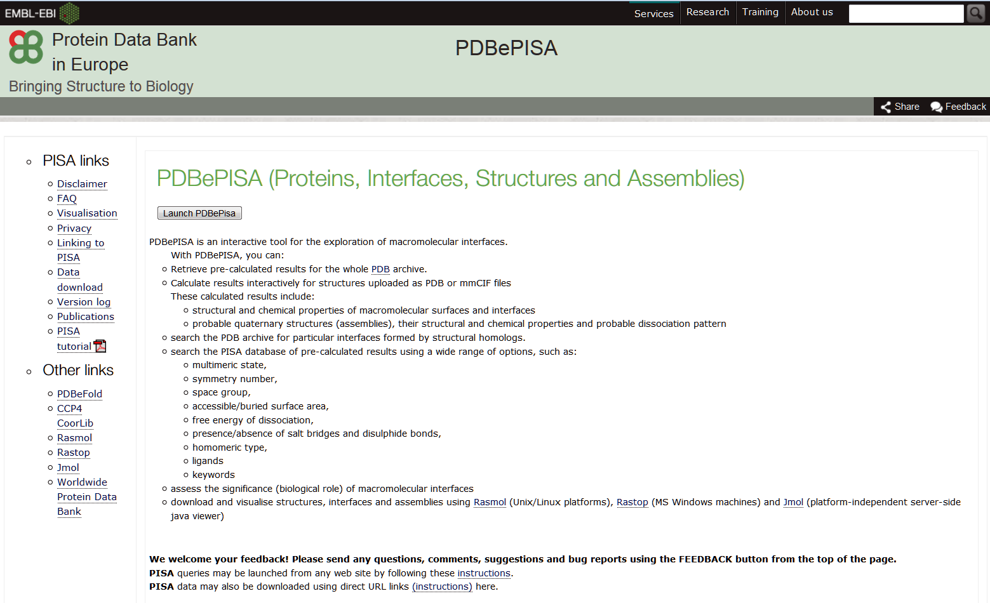
Protein-protein interfaces. PISA
www.ebi.ac.uk/msd-srv/prot_int/pistart.html

Slide 13
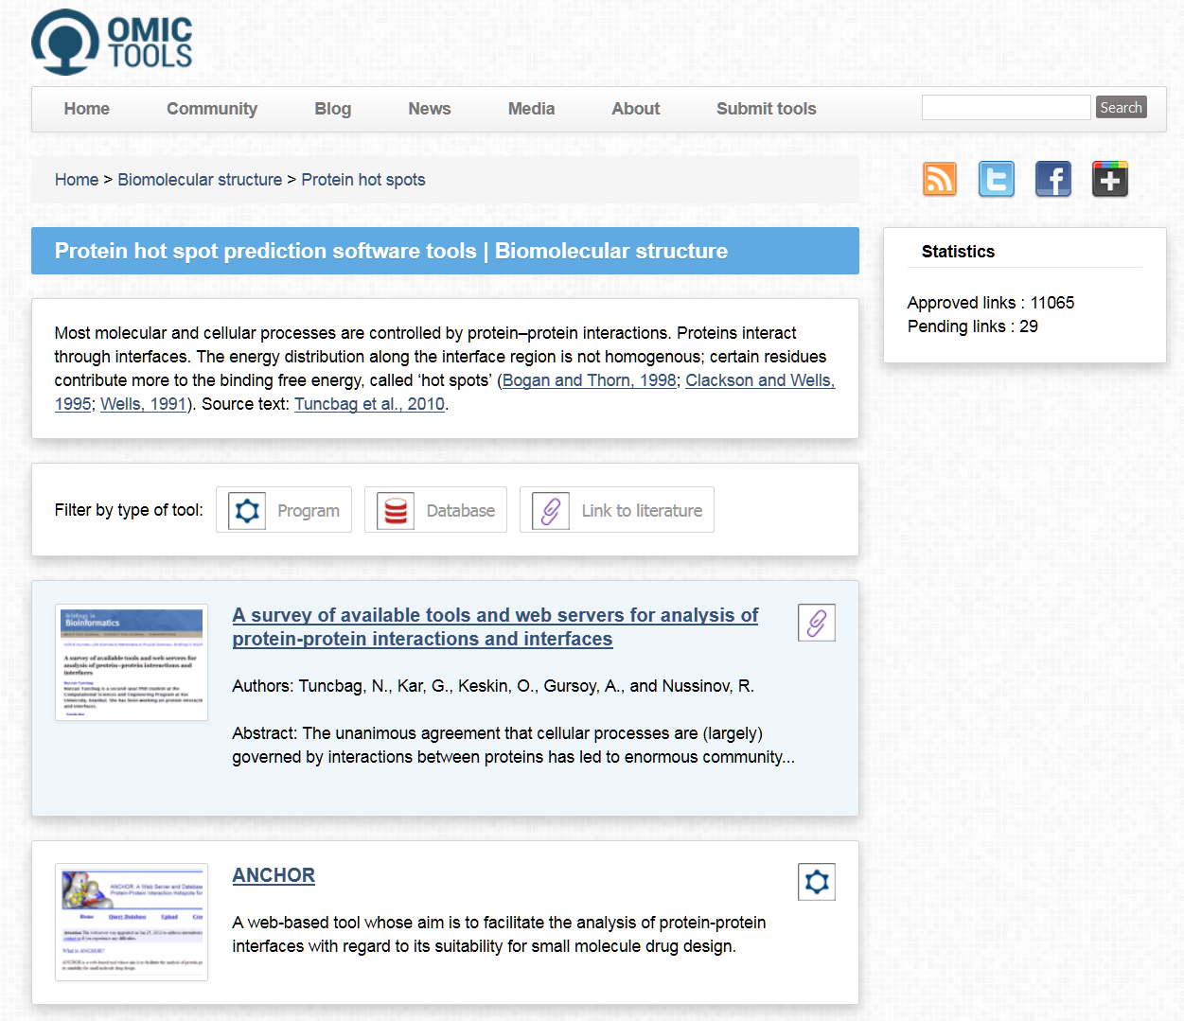
Protein-protein interfaces. Hot spots
omictools.com/protein-hot-spots-c1159-p1.html

Slide 14
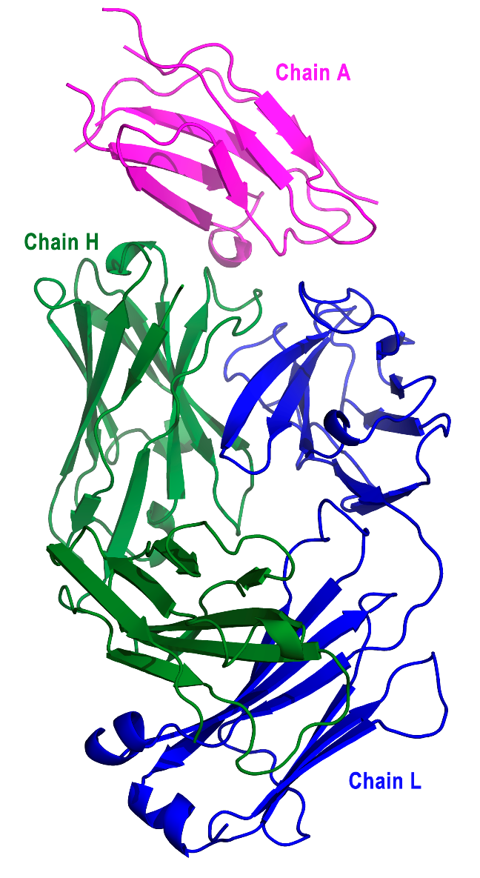
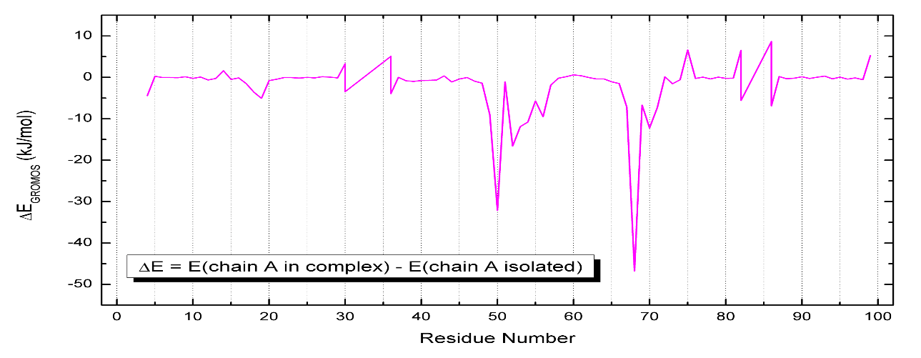
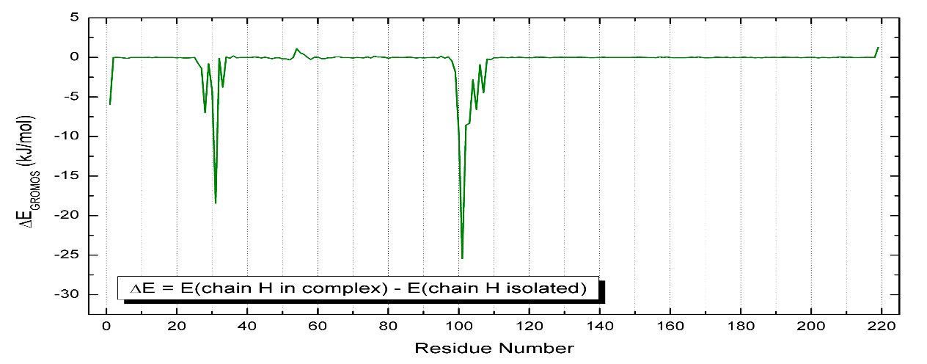
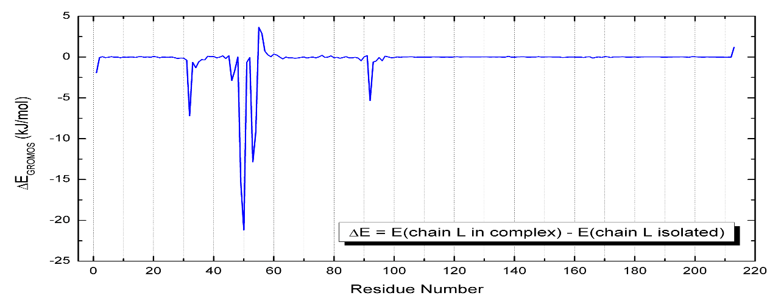
3WIH (SEP 2013; article FEB 2015)
CRYSTAL STRUCTURE OF THE THIRD
FIBRONECTIN DOMAIN (FN3) OF HUMAN
ROBO1 IN COMPLEX WITH THE FAB
FRAGMENT OF MURINE MONOCLONAL
ANTIBODY B2212A
LFP

Slide 15
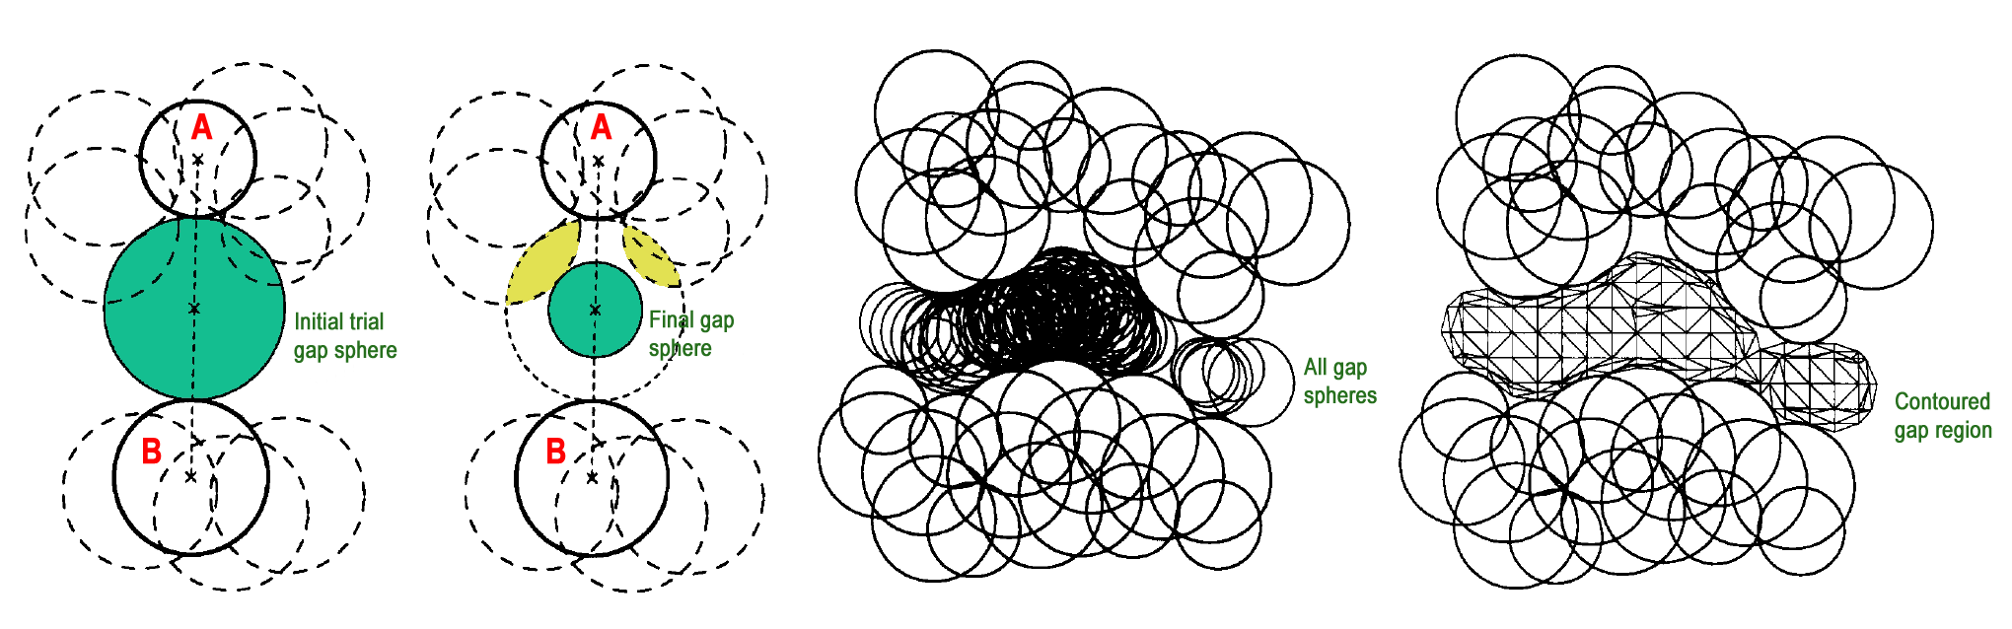
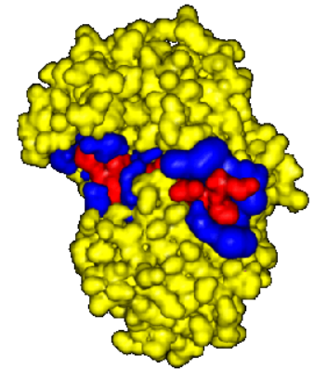
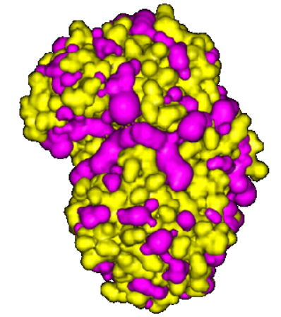
SURFNET
1
Protein-inhibitor complex (3ER5)
Protein: aspartic protease
endothiapepsin (yellow)
Inhibitor: pepstatin (red)
The gap regions between the
two surfaces are shown in blue
2
Gap regions in a protein (3ER5)
Aspartic protease
endothiapepsin (yellow)
All clefts and cavities are
shown in magenta
3
1: LFP based on: R. A. Laskowski (1995), J. Molec. Graph. 13:323-330 2,3: glab.cchem.berkeley.edu/glab/surfnet/

Slide 16
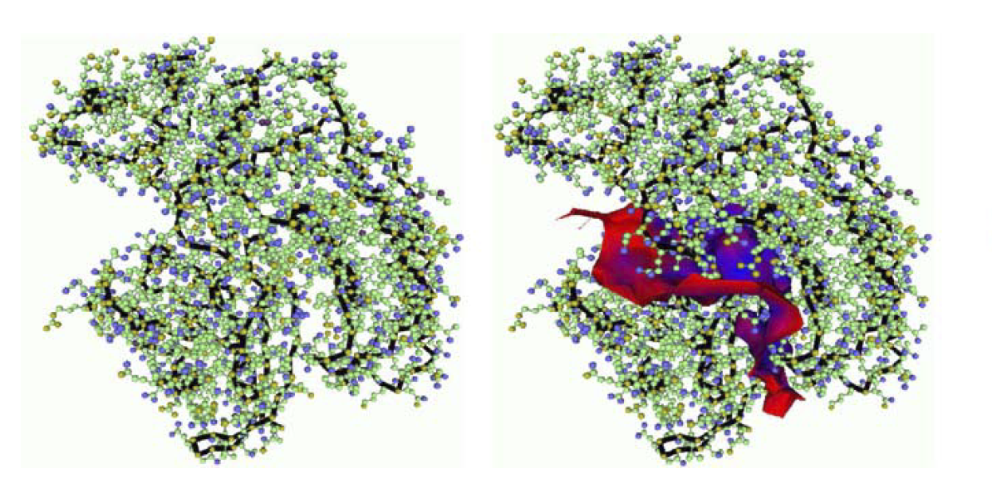
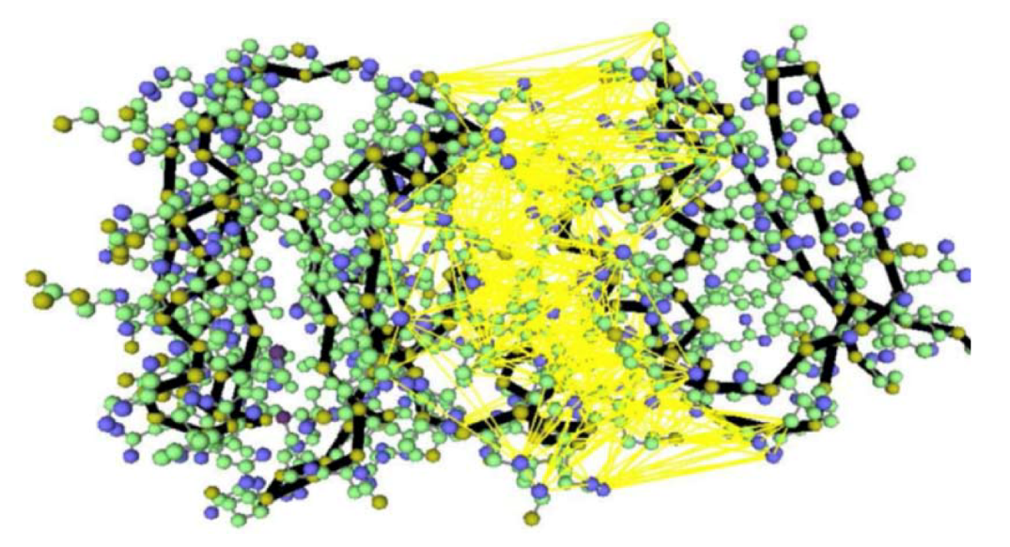
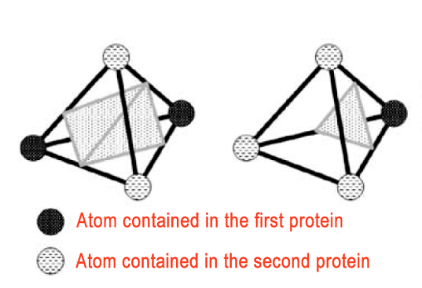
INTERSURF
1
Zero isosurface of the function
f (x) = dist(x, prot A) – dist(x, prot B)
dist(x,P): minimal distance between
point x and protein P
2
Delaunay tetrahedralization of the
empty space between two proteins
Volume is decomposed into
tetrahedra using atoms as vertices
3
Zero isosurface of f (x): the protein-protein interface is constructed with triangles computed from these tetrahedra
1-3: N. Ray, X. Cavin, J. C. Paul, B. Maigret (2005), J. Molec. Graph. Model. 23:347-354

Slide 17
Dielectric function
Water
D´ = 78.54
Protein interiors
D = 2 - 6
LFP

Slide 18
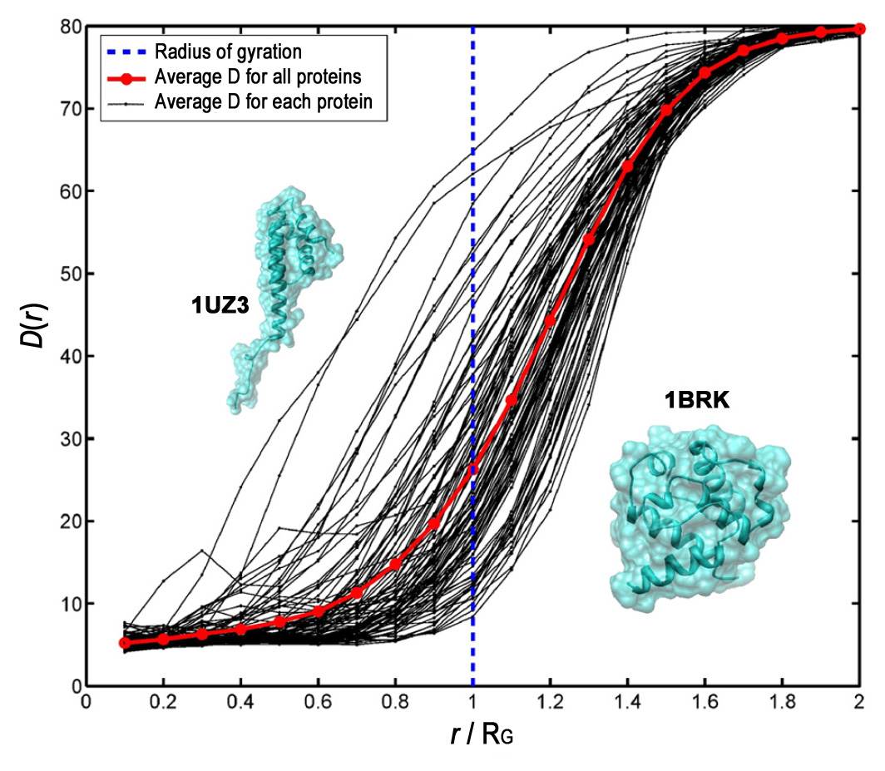
Dielectric function in 91 proteins
LFP adapted from: L. Li, C. Li, Z. Zhang, E. Alexov (2013), J. Chem. Theory Comput. 9:2126-2136

Slide 19
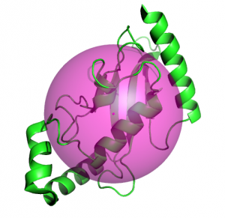
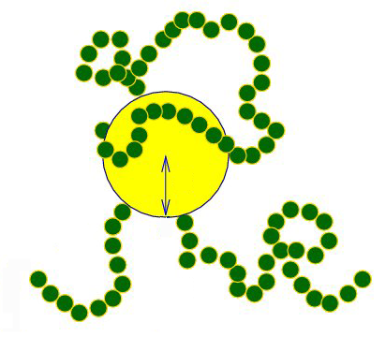
Radius of gyration (RG)
1
RG: Radius of the sphere having
the same mass and same
moment of inertia as the protein
Macromolecule M (kg mol⁻¹) RG (Å)
Serum albumin 66 29.8
Myosin 493 468
Polystyrene 3.2×10³ 500
DNA 4×10³ 1170
Tobacco mosaic virus 3.9×10⁴ 924
2
1: www.pymolwiki.org/index.php/Radius_of_gyration 2: www.physics.ucsf.edu/~aniket/research/May17_research.html

Slide 20
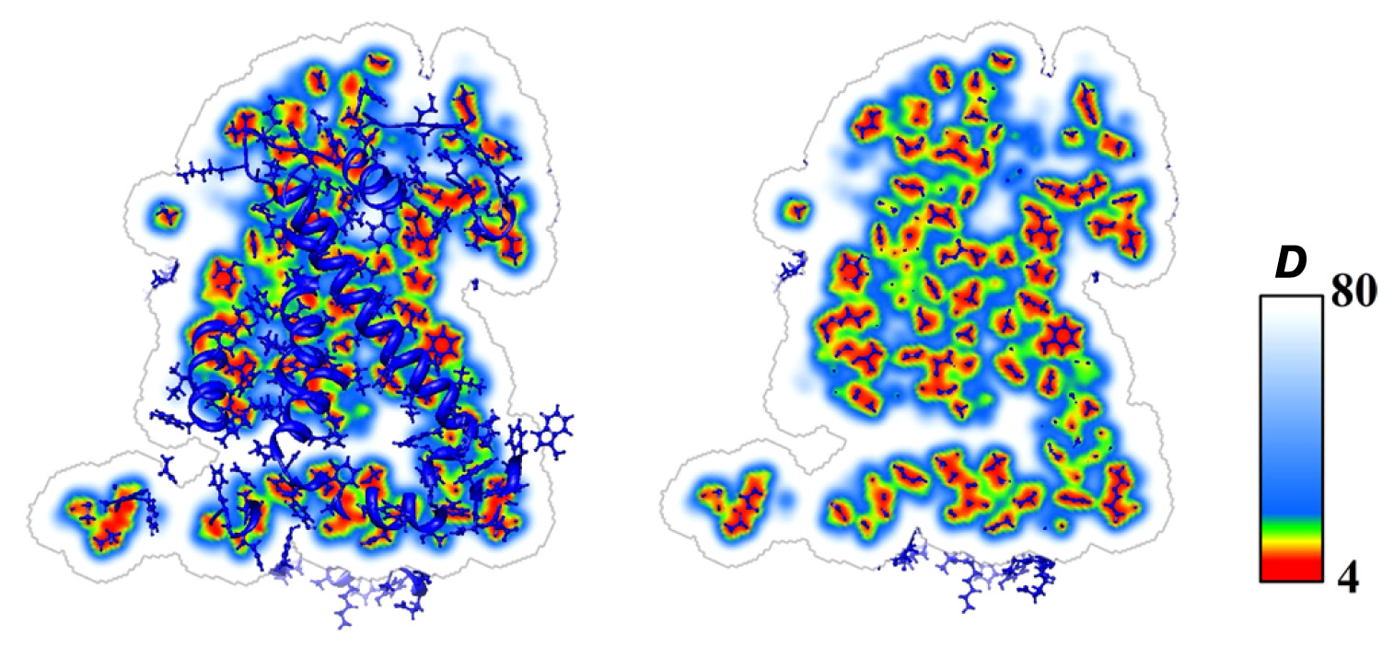
Dielectric distribution within a protein
1AIJ: Photosynthetic reaction center from Rhodobacter sphaeroides
Slice of D distribution and Slice of D distribution with
the entire protein structure atoms close to this slice
LFP adapted from: L. Li, C. Li, Z. Zhang, E. Alexov (2013), J. Chem. Theory Comput. 9:2126-2136

Slide 21
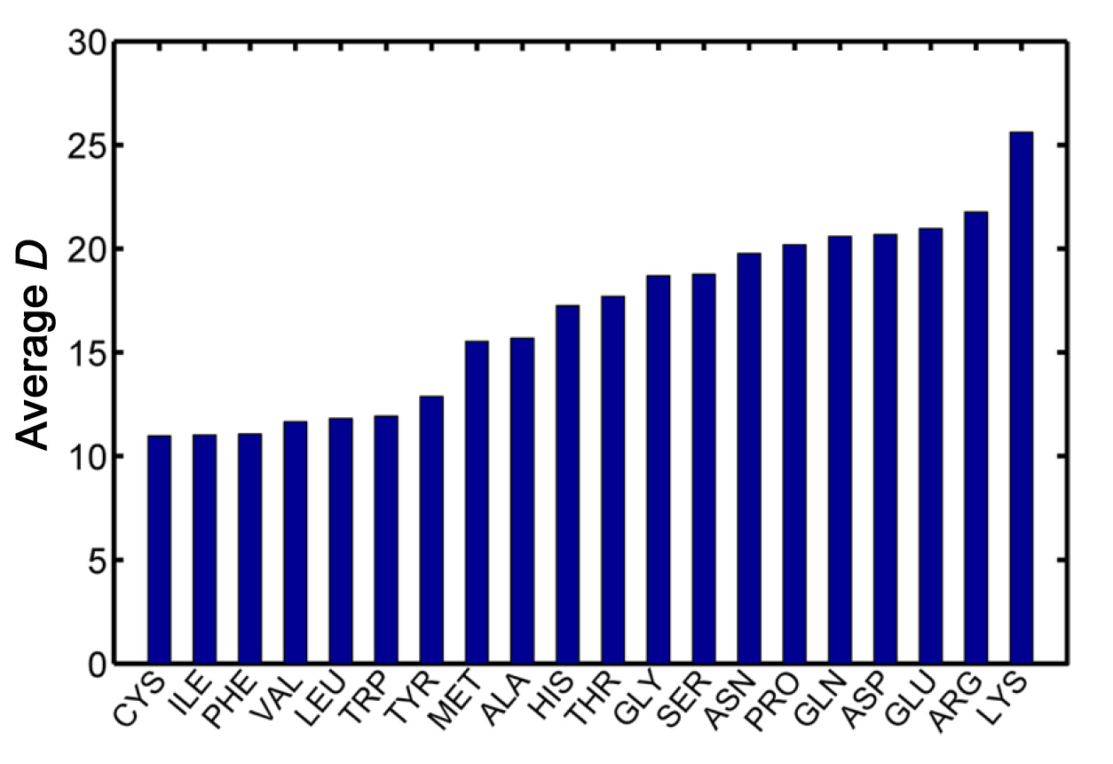
Dielectric constant of residues
LFP adapted from: L. Li, C. Li, Z. Zhang, E. Alexov (2013), J. Chem. Theory Comput. 9:2126-2136

Slide 22
APBS: Adaptive Poisson-Boltzmann Solver
* Solve numerically the PB equation (PBE) using finite element methods combined with
electrostatic focusing
* The first step is the calculation of a low-accuracy solution of the EPB on a coarse mesh of
points spanning the entire spatial domain around the protein
* This coarse solution is then used in conjunction with an error estimator to partition the
problem domain into P subdomains, which are assigned to P processors of a parallel computer
* Each processor then solves the PBE over the global mesh of points but confines its adaptive refinement to the local subdomain and a small surrounding region on a fine mesh
* After all processors have completed their local adaptive solutions, a global solution is
constructed by the piecewise assembly of the solutions of each subdomain (it can be rigorously shown that this assembled solution is as accurate as the solution on a single global mesh)
* Because each processor performs all of its computational work independently, APBS
calculations exhibit excellent parallel scaling

Slide 23
# PB Potential for 1BLZ protein title (# : comment lines)
read
mol pqr 1BLZ.pqr read PQR file for molecule 1
end
elec
mg-auto automatic multigrid calculations
dime 193 193 193 number of grid points per processor (1)
cglen 110.146 110.146 114.493 length of coarse grid in focusing calculation
fglen 84.792 84.792 87.349 length of fine grid in focusing calculation
cgcent mol 1 center coarse grid on molecule 1
fgcent mol 1 center fine grid on molecule 1
mol 1 specify molecule for which the PBE is solved
npbe solve the nonlinear PBE (2)
bcfl mdh type of boundary conditions (3)
pdie 4.00 protein (solute) dielectric
sdie 78.54 solvent dielectric
ion charge 1 conc 0.150 radius 2.0 specify positive ions
ion charge -1 conc 0.150 radius 2.0 specify negative ions
chgm spl2 method to map atom charges to the grid (4)
sdens 10.0 sphere density for accessibility (5)
srfm smol molecular surface definition (6)
srad 1.40 solvent sphere probe radius
swin 0.30 spline window width (Å); recommended 0.30
temp 298.15 temperature in kelvin
calcenergy no energy not computed
calcforce no force not computed
write pot dx 1BLZ_pot write potential in OpenDX format to 1BLZ_pot.dx file (7)
end
quit
psize.py

Slide 24
PDB file occupancy B factor
ATOM 1 N THR 1 17.047 14.099 3.625 1.00 13.79
ATOM 2 CA THR 1 16.967 12.784 4.338 1.00 10.80
ATOM 3 C THR 1 15.685 12.755 5.133 1.00 9.19
ATOM 4 O THR 1 15.268 13.825 5.594 1.00 9.85
ATOM 5 CB THR 1 18.170 12.703 5.337 1.00 13.02
ATOM 6 OG1 THR 1 19.334 12.829 4.463 1.00 15.06
ATOM 7 CG2 THR 1 18.150 11.546 6.304 1.00 14.23
ATOM 8 N ALA 2 15.115 11.555 5.265 1.00 7.81
ATOM 9 CA ALA 2 13.856 11.469 6.066 1.00 8.31
PQR file charge Q radius R
ATOM 1 N THR 1 17.047 14.099 3.625 -0.3000 1.8500
ATOM 2 CA THR 1 16.967 12.784 4.338 0.2100 2.2750
ATOM 3 C THR 1 15.685 12.755 5.133 0.5100 2.0000
ATOM 4 O THR 1 15.268 13.825 5.594 -0.5100 1.7000
ATOM 5 CB THR 1 18.170 12.703 5.337 0.1400 2.2750
ATOM 6 OG1 THR 1 19.334 12.829 4.463 -0.6600 1.7700
ATOM 7 CG2 THR 1 18.150 11.546 6.304 -0.2700 2.0600
ATOM 8 HG22 THR 1 17.759 10.731 5.863 0.0900 1.3200
ATOM 9 H2 THR 1 17.853 14.588 3.947 0.3300 0.2245
ATOM 10 H3 THR 1 17.116 13.928 2.646 0.3300 0.2245
ATOM 11 HB THR 1 18.142 13.494 5.933 0.0900 1.3200
ATOM 12 H THR 1 16.223 14.622 3.826 0.3300 0.2245
ATOM 13 HG21 THR 1 19.084 11.332 6.608 0.0900 1.3200
ATOM 14 HG23 THR 1 17.593 11.776 7.109 0.0900 1.3200
ATOM 15 HA THR 1 16.944 12.070 3.646 0.1000 1.3200
ATOM 16 HG1 THR 1 19.855 13.646 4.713 0.4300 0.2245
ATOM 17 N ALA 2 15.115 11.555 5.265 -0.4700 1.8500
ATOM 18 CA ALA 2 13.856 11.469 6.066 0.0700 2.2750

